Slide 1

Battery

Slide 2
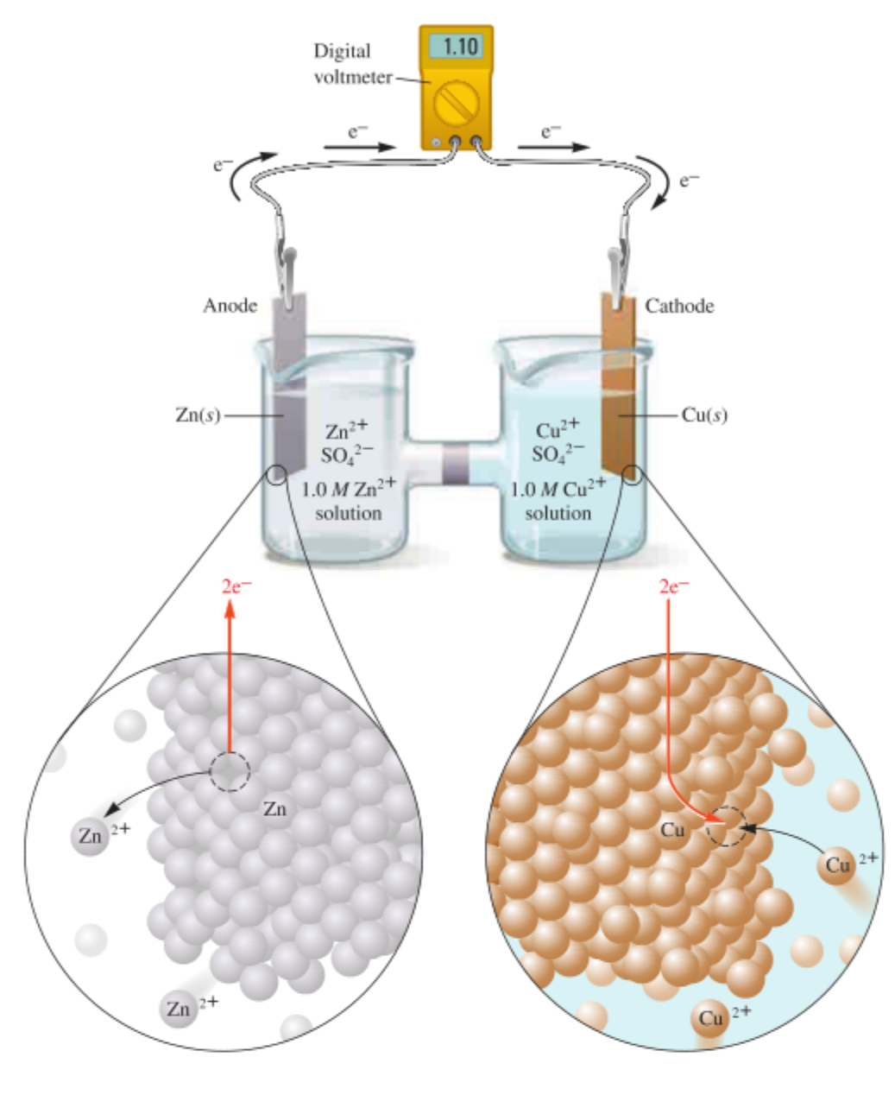
Principle
Anode: oxidation reaction
Cathode: reduction reaction
Electrons go from anode to cathode in the external circuit
Ions go from cathode to anode in the electrolyte.
Traditional Zinc-Copper Primary Battery
Zumdahl, Steven S., and Donald J. DeCoste. Chemical principles. Nelson Education, 2012.

Slide 3
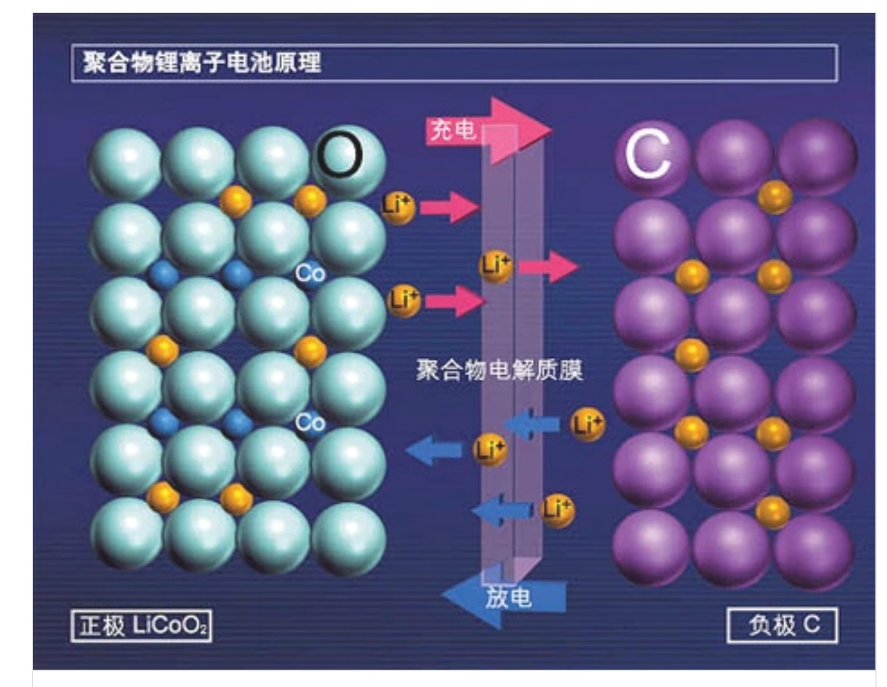

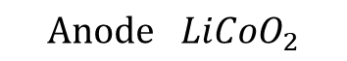
Lithium Ion Battery
Traditional Lithium Ion Battery
Materials that lithium ions are able to intercalation and deintercalation into.
Charging: Anode to Cathode
Discharging: Cathode to Anode
Charging
Discharging
$$Anode LiCoO_{2}$$
$$Cathode C$$
Lithium ion cells and batteries. Accessed on: March 24, 2021. [Online]. Available: https://baike.baidu.com/item/%E9%94%82%E7%A6%BB%E5%AD%90%E7%94%B5%E6%B1%A0

Slide 4
Advantage and Disadvantage of Lithium Ion Battery
Advantage:
Small volume
Rechargeable
Long cycle life
Disadvantage:
Life and performance are highly to related to external environments

Slide 5
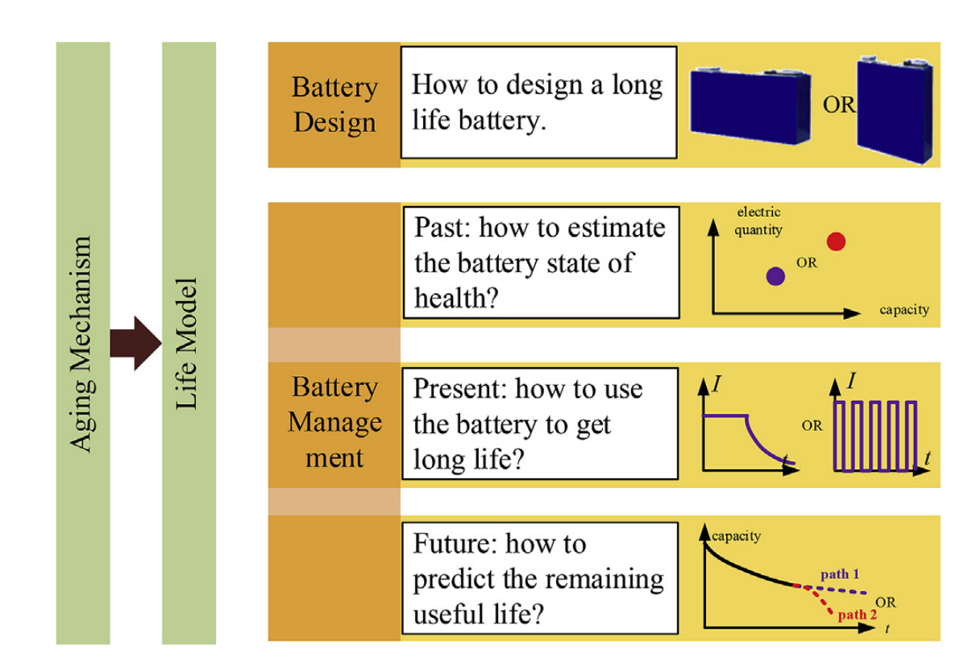
Challenges – Battery Degradation
The power and capacity of the battery will fade after recharging for several cycles.
There are so many factors that impact, it is hard to know its aging mechanism.
However, it is important to know its aging mechanism.
Xuebing, et al. "A review on the key issues of the lithium ion battery degradation among the whole life cycle - ScienceDirect." eTransportation 1:100005-100005.

Slide 6
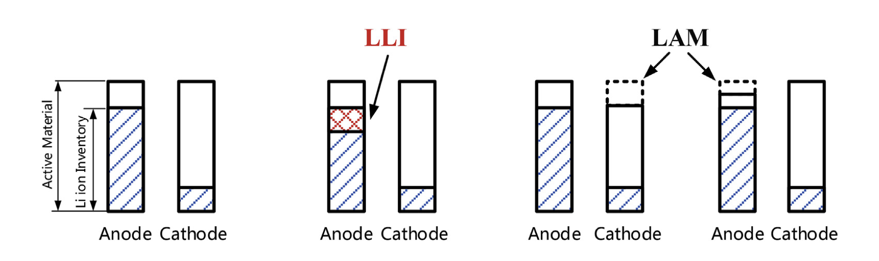
Main Reason
Loss of lithium ion inventory (LLI)
Loss of anode/cathode active materials (LAM)
Dual-tank Example
Xuebing, et al. "A review on the key issues of the lithium ion battery degradation among the whole life cycle - ScienceDirect." eTransportation 1:100005-100005.

Slide 7
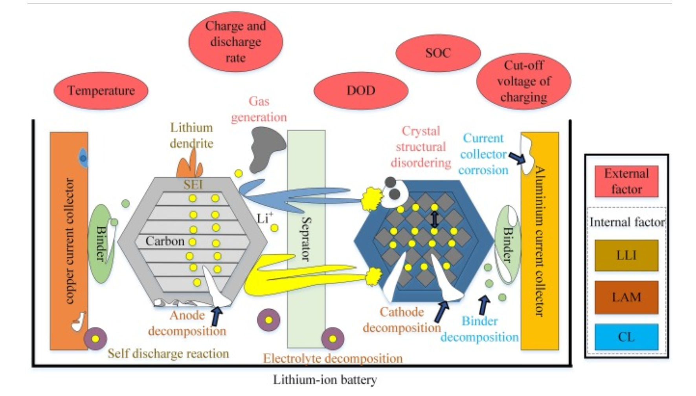
More Details
Solid Electrolyte Interface (SEI) Film
Tian, H. , et al. "A review of the state of health for lithium-ion batteries: Research status and suggestions." Journal of Cleaner Production 261.1(2020):120813.
Notes:
Based on the current literature, battery aging is mainly caused by external environmental factors and internal factors. External environmental factors refer to the location where the battery is situated and its operating environment, such as temperature (Wang et al., 2018a, Ma et al., 2014), charge and discharge rate (Gao et al., 2017a, Maher and Yazami, 2013), depth of discharge (DOD) (Meng et al., 2016, Omar et al., 2014), and the cut-off voltage of charging (Notten and Danilov, 2014, Gao et al., 2017b). The internal factors mainly refer to three influencing mechanisms: the loss of lithium inventory (LLI) (Jiang et al., 2019a, Castro et al., 2012), the loss of active material (LAM), and conductivity loss (CL). The LLI includes the generation of an SEI layer (Kim et al., 2013), the formation of lithium dendrites (Shen et al., 2017), and the self-discharge of a battery (Lang et al., 2016, Liu et al., 2012, Sarasketa-Zabala et al., 2015). The LAM comprises the decomposition of cathode material (Liu et al., 2012), the decomposition of anode material (Kim et al., 2013), and the decomposition of the electrolyte (Kassema et al., 2012, Li et al., 2015). The CL mainly refers to the aging mechanism that causes the battery’s current collector to break and decompose and the battery adhesive to peel off and degrade (Pastor-Fernandez et al., 2017, Yang and Dai, 2019).

Slide 8

Thank you!

